Slide 1


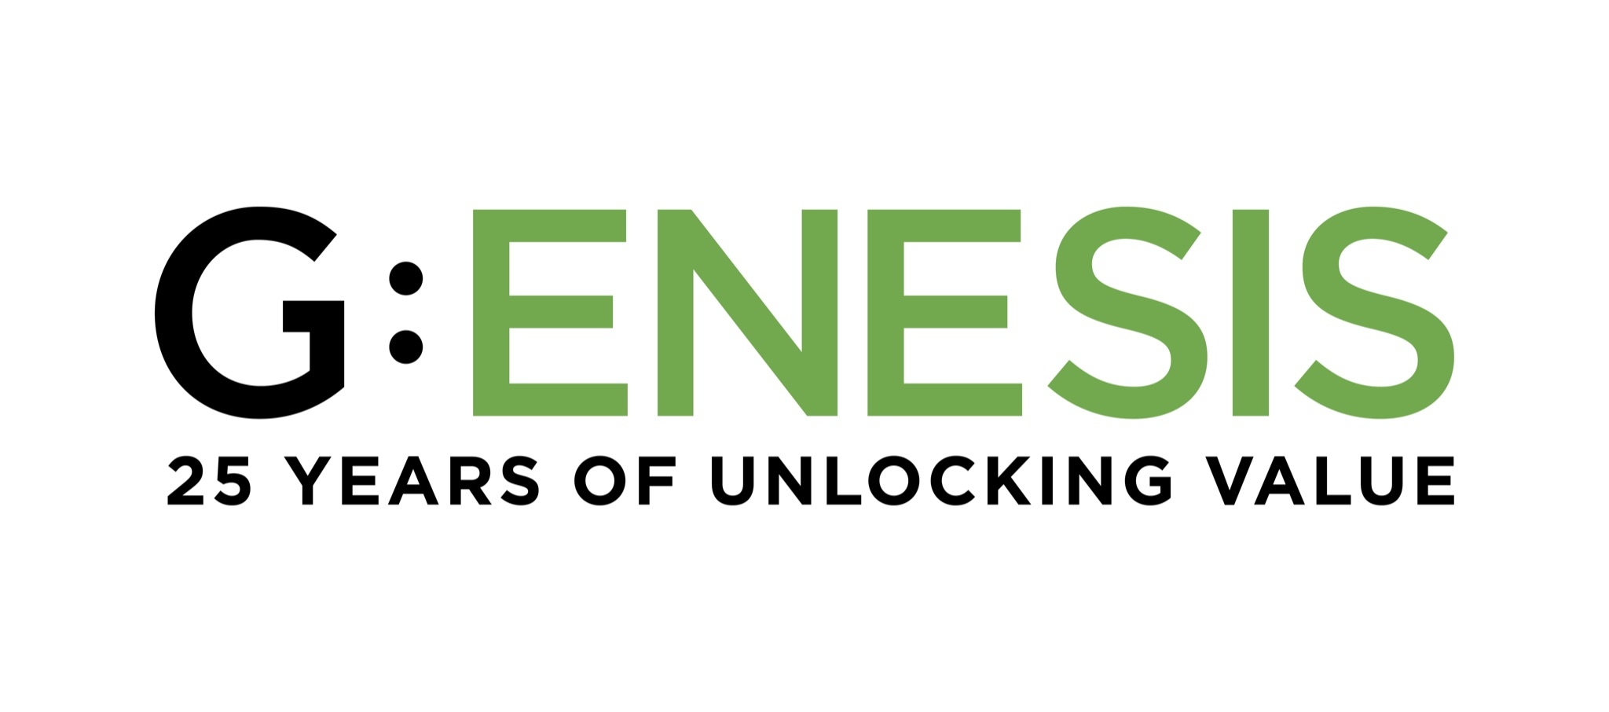
MOJACOM 29
Open Source vs Licensed Software vs Proprietary Build for Instant Payment Systems
21-23 October 2025

Slide 2
Table of Contents
01
Background and Context
06
What are the factors that determine what software ownership model fits best?
02
Summary of each type of model
07
Comparative analysis
03
Open Source Model
08
Conclusion
04
Licensed Software Model
09
Q & A
05
Proprietary Model

Slide 3
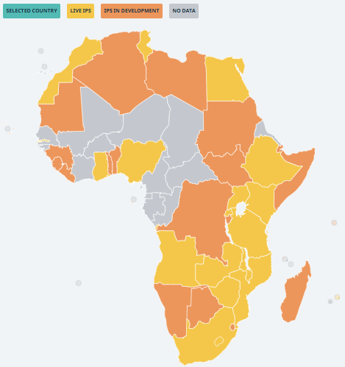
The Instant Payments Revolution: Which Software Ownership Model is Right for You?
The Accelerated Growth of IPS: Instant Payment Systems (IPS) are no longer an innovation; they are foundational economic infrastructure. The number of live systems has more than quadrupled in the last decade, with dozens more in planning stages across Africa and the globe.
1
2
From Millions to Billions: Global IPS volumes are exploding, driven by the demand for real-time, data-rich, and low-cost digital payments. Transaction volumes grew from 14.1 billion in 2019 to 49 billion in 2023, an average annual growth rate of 37%.¹
Unlocking Economic Value: The right technical foundation is essential to sustainably manage this growth, lower costs for end-users, and unlock the full economic potential of an instant, interoperable payments ecosystem.
3
4
A Critical Crossroads: This rapid adoption presents a critical strategic choice for central banks, switch operators, and governments: how do we build, own, and operate this vital rail?
The Core Question: The decision between building on open-source software, licensing a proprietary solution, or building from scratch, has long-term implications for a country's cost, control, and capacity for innovation.
5
Sources: 1. AfricaNenda SIIPS 2024 | Image from AfricaNenda’s African IPS Map
‹#›

Slide 4
A Summary of the Models: What are your Options?
1
Open Source
2
Licensed Software
3
Proprietary Build
The Motto: "Build together, own together."
The Model: Deploy a switch whose core code is publicly available under an open-source license (e.g., Mojaloop). You host it yourself or with a local partner, eliminating license fees. Enhancements can be contributed back to the community.
You get: Full code access, no license fees, high flexibility.
You need: Strong in-house or partner engineering capacity.
The Motto: "License the code, run it yourself."
The Model: Acquire a proven, enterprise-grade system from a specialized vendor. You install it in your domestic data centers and operate it with your own staff, paying an upfront license fee plus annual maintenance.
You get: A market-tested platform, vendor support, predictable costs.
You need: Budget for license fees and a skilled operations team.
The Motto: "Own the code, own the rail."
The Model: Design, code, host, and operate the entire system yourself. Your internal team builds a fully bespoke solution from the ground up, giving you 100% IP control and ownership.
You get: Total control, unlimited customization, no vendor lock-in.
You need: Significant CapEx, a long timeline, and a deep pool of talent.
‹#›

Slide 5
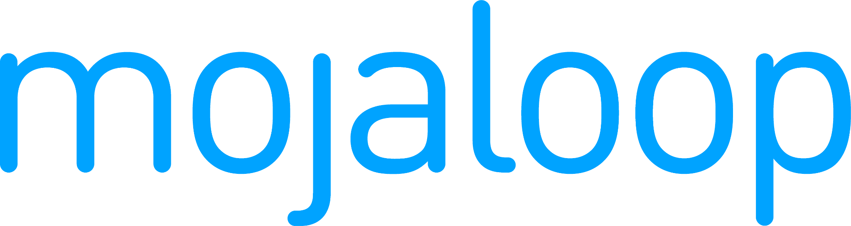
Open Source: Collaborative, Transparent, and Sovereign
The core principle is that the software's source code is a shared public asset, allowing for transparency, community-driven innovation, and adaptation.
How it Works
The Prime Example:
Zero License Fees: The core software is free, shifting costs to implementation, customization, and support.
Avoids Vendor Lock-in: You own your deployment and can change support vendors. This gives you long-term negotiating power and strategic independence.
Full Ownership & Control: You can freely modify the code to meet unique local needs without needing vendor approval.
Community Power: You benefit from a global community of developers who contribute features, identify bugs, and provide peer support.
Mojaloop is an open-source software platform developed by the Mojaloop Foundation to enable interoperable, real-time payment systems that lower costs, reduce technical barriers, and advance financial inclusion, particularly in emerging markets.
It has been deployed at national and regional scale, including in Rwanda and Tanzania.
The Role of System Integrators
System Integrators (SIs) are the crucial bridge between the open-source software and the operational reality of a payments ecosystem.
Their role involves deploying the software, tailoring it to meet local requirements, setting up infrastructure, integrating participants, testing, quality assurance, and providing ongoing support.
‹#›

Slide 6
Open Source in Action: Rwanda's eKash
Key lessons from current African deployments
The Challenge: Rwanda's central bank sought to modernize its national payment system to enhance interoperability and security. A key policy objective was achieving full sovereignty, having a completely auditable switch free from vendor dependency.
The Solution & The Role of the System Integrator: RSwitch partnered with System Integrator WiredIn to build its new system, eKash, on the Mojaloop platform. WiredIn managed the full on-premise deployment, including all core components and customizations to meet local business requirements.
This technical work included integrating with major financial service providers using custom ISO 20022 protocols and building a customized Account Lookup Service.
The Outcome: To accelerate ecosystem adoption, a transaction simulator was implemented, allowing partners to test and validate use cases before full integration.
The result is a sovereign, inspectable platform that meets Rwanda's policy goals. The partnership with a skilled system integrator was critical to translating the open-source software into a fully operational and locally-attuned national payment switch.
Contribute your changes back to the main project regularly, like Rwanda does with Mojaloop, to avoid maintaining a separate version.³
Set aside funds early for security audits, like Tanzania’s TIPS did to certify their open-source platform via PCI SSF and ISO 27001 reviews.
Invest in community engagement by sending engineers to community engagements such as the bi-annual Mojaloop meetings; to fast-track skills transfer and peer review.
Automate weekly security updates using continuous integration and deployment tools to include community fixes without waiting for the vendor’s schedule.
‹#›

Slide 7
Licensed Software: Proven, Predictable, and Supported
The core principle is buying a mature, market-tested product from a vendor. This de-risks the technical build and provides a clear path to launch.
How it Works
Key Strengths
Commercial Terms: Involves an upfront license fee plus a recurring annual maintenance fee (15-20% of license cost).
On-Premise Control: The software is installed on your servers, ensuring data residency.
High Vendor Lock-in: This is the primary trade-off. You become highly dependent on the vendor for support, upgrades, and new features. Exiting the contract is costly and complex.
Mitigating Risk: Source code is often held in a legal escrow agreement, which provides access only in extreme cases like vendor bankruptcy, but does not solve the fundamental issue of dependency.
Reliability: You are deploying an enterprise-grade platform that is proven to work at scale in multiple other markets.
Defined Support: The model comes with formal Service Level Agreements (SLAs) for technical support and uptime.
‹#›

Slide 8
Licensed Software in Action: Malawi's National Switch
The Challenge: Malawi needed to establish a reliable national card and instant payment switch to interconnect its financial institutions, prioritizing a proven solution and secure in-country data hosting.
The Solution: Natswitch chose the software licensing model, acquiring its platform from a global payments technology vendor. The system was deployed on Natswitch's own hardware in their data centers within Malawi.
The Outcome: Malawi launched a robust, market-tested system with the assurance of vendor support. While this creates vendor dependency, it was a strategic trade-off for speed and reliability, while still meeting data sovereignty requirements.
Key lessons from current African deployments
Lock in maintenance pricing before launch by negotiating a flat percentage of the licence cost to avoid step-function fee hikes later.
Demand open Application Programming Interface from day one to quickly layer on mobile-money and QR services without touching core code.
Stage upgrades in a sandbox environment are replicated from production to reduce live-system outage risk.
Leverage data recovery site licensing discounts by building active-active now, dodging future list prices when traffic surges.
Budget an “innovation buffer”, a small internal dev squad building microservices around the switch so Namclear is not blocked by the vendor’s roadmap.
‹#›

Slide 9
Proprietary Build: Absolute Control, Unmatched Flexibility
The core principle: If you want total control and independence, you build it yourself. This model involves funding and executing the entire project in-house.
How it Works
The Strategic Bet
Full IP Ownership: You own 100% of the source code and intellectual property. The platform is a strategic national asset.
Zero Vendor Lock-in: The system is completely independent of any third-party vendor's roadmap, pricing, or business stability.
Unlimited Customization: The system is built to your exact specifications, and you can innovate freely.
Highest Investment: This model requires the most significant upfront CapEx and the longest timeline (typically 18-60 months) before launch.
This is a long-term investment in national technical capacity.
The high initial cost can deliver strong ROI over many years, especially in high-volume markets, as there are no recurring license fees.
Success requires a long-term commitment to funding and nurturing top-tier local tech talent.
‹#›

Slide 10
Proprietary Build in Action: Nigeria's NIP
Key lessons from current African deployments
The Challenge: Nigeria's policy required a sovereign, locally built real-time payment system to be a core national asset, completely free from foreign vendor control and influence.
The Solution: The Nigeria Inter-Bank Settlement System (NIBSS) was tasked with building the NIBSS Instant Payments (NIP) system from the ground up with its own in-house engineering team.
The Outcome: NIBSS has absolute control over NIP's technology and roadmap. This independence has enabled them to scale it into one of the world's most successful instant payment systems. The strategy successfully eliminated vendor lock-in and built a deep pool of payments technology talent in Nigeria.
Launch with a minimal-viable-product and iterate rapidly. Initially, India used UPI mainly for person-to-person (P2P) payments, and only later did UPI layers add merchant payments (P2M), mandates, and credit.
Embed PCI-SSF and ISO 20022 compliance from day one, as retrofitting later can run from a few thousand dollars to USD 500,000+, dwarfing initial implementation costs.
Design for explosive growth with horizontal scaling and active-active data centres to handle orders-of-magnitude volume jumps. NIBSS Instant Payment Platform volume rose 613 percent from 729 million in 2018 to 5.2 billion in 2022, forcing banks to quadruple capacity in just five years.
Build a talent moat by pairing competitive pay with knowledge-sharing programmes to diffuse key-person risk.
‹#›

Slide 11





A Framework for Your Decision: 10 Key Variables
Regulatory fit
Commercial
terms
Capital Expenditure
Operational Expenditure
Performance /
scalability
Lock-in & exit
risk
Implementation
speed
Customization
capability
Software code
ownership
Talent requirement
‹#›

Slide 12
Comparing the Models: Financials & Time to Market
Variable | Open Source | Licensed Software | Proprietary Build
Upfront Cost (CapEx) | Medium. No license fee, but requires investment in integration and hardware. | High. Significant one-time perpetual license fee plus hardware costs. | Very High. Funds the entire multi-year software development effort from scratch.
Ongoing Cost (OpEx) | Medium. Primarily staff costs. Optional support contracts. No license fees. | Medium-High. Includes recurring annual maintenance fees (15-20% of license) plus staff costs; change requests add unpredictable expenses. | High. Driven entirely by the payroll for a large in-house technical team.
Commercial Terms | Favorable. No license fees or revenue share. Costs are for implementation and optional ongoing support contracts. | Fixed. Involves an upfront perpetual license fee plus a mandatory, recurring annual maintenance fee. | Internal. Operator retains all revenue with no vendor royalties and self-funds all development and maintenance.
Cost at Scale | Favorable. Costs do not automatically scale with transaction volume. | Unpredictable. Licensing and annual maintenance costs are fixed; change requests can grow large and unpredictable with scale. | Most Favorable. After the initial build cost, per-transaction costs become very low.
Implementation Speed | Medium. Typically 9-15 months for customization and launch. | Fast. A proven platform allows for a more streamlined 6-12 month deployment. | Slowest. A full greenfield build requires 18-60 months before go-live.
Legend | Unfavourable | Middle ground | Favourable
‹#›

Slide 13
Comparing the Models: Governance & Flexibility
Variable | Open Source | Licensed Software | Proprietary Build
Governance & Control | Full. You own your deployment and control the roadmap. Community input is a resource. | Shared. You control daily operations, but the vendor controls the core product roadmap. | Absolute. You have total, unilateral control over every feature, policy, and timeline.
Customization | Unlimited. Full source code access allows you to modify any module to fit your needs. | Medium. Core changes require paid requests to the vendor and are subject to their timeline. | Unlimited. The system is built from the ground up to be perfectly tailored to your requirements.
Software Ownership | Full. You own your customized instance of the code forever. | Limited. You have a license to use the software. The vendor retains all IP. | Full. You own 100% of the intellectual property and the source code.
Vendor Lock-in & Exit Risk | Minimal. Low cost to exit and you can switch support partners. Risk is in knowledge transfer. | High. Exit is technically complex and financially costly, creating significant long-term dependency. | None. Complete independence from third-party vendors is a primary feature of this model.
Talent Requirement | High. Requires a strong in-house or partner team of developers and DevOps engineers. | Medium. Requires a skilled team of system administrators trained by the vendor. | Very High. Requires a large, permanent, and multi-disciplinary team of top-tier tech talent.
Legend | Unfavourable | Middle ground | Favourable
‹#›

Slide 14
Software Licensing gives fast, reliable entry while Open-source and proprietary builds remove licence costs and maximizes flexibility yet demands skilled in-house teams
Model | Strengths | Weaknesses | Limitations
Open-source Model | Zero license fees; significant cost savings from annual licensing fees, annual support and maintenance fees Community-driven innovation. Full code transparency for unlimited adaptation. Data sovereignty | Requires a skilled in-house team to integrate and secure code and solution, but this helps build internal skills and capacity. Community support lacks formal SLAs. | Potential security/compliance gaps if not patched promptly. Updates depend entirely on community activity.
Proprietary Build Model | Fully tailored to exact business requirements. Complete control over feature roadmap and timing. | Very high development cost and resource intensity. Slower time-to-market compared to packaged options. | Ongoing maintenance burden falls entirely on internal teams. Risk of stagnation if resources shift away or priorities change.
Software Licensing Model | Clear ownership rights via a one-time or term license. Technology vendor support with routine updates. | Large upfront license fees and upgrade costs can strain the budget. Requires significant hosting infrastructure. | Rollout pace depends on vendor delivery. Usage and scaling are limited by license terms.
‹#›

Slide 15
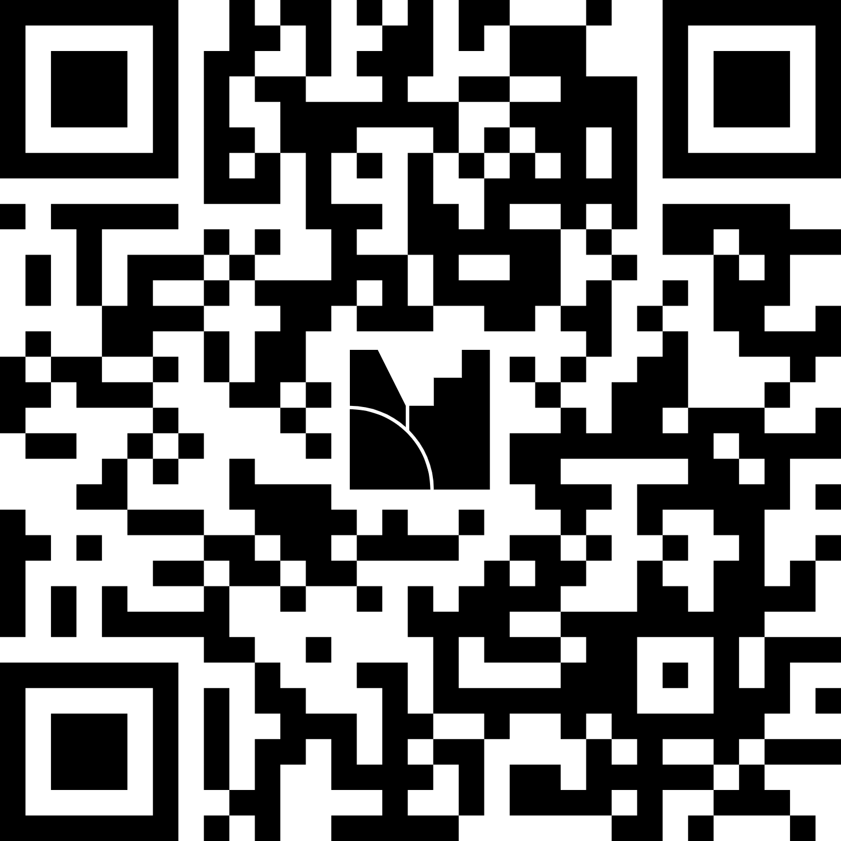
Let’s hear from you…
In your view, what are the most important factors when deciding on an IPS software ownership model?
Respond using this link
https://www.menti.com/al8p3puzb286
Or visit menti.com and input this code:
1813 7413
Or scan the QR code
‹#›

Slide 16
Let’s hear from you…
Based on what we’ve learned so far, what is the best software ownership model for an IPS?
Respond using this link
https://www.menti.com/al8p3puzb286
Or visit menti.com and input this code:
1813 7413
Or scan the QR code
‹#›

Slide 17

Conclusion: It Depends…
To find your answer, ask these key questions:
What is our most critical driver: Speed, Cost, or Control?
What is our realistic CapEx budget and long-term OpEx tolerance?
How damaging is Vendor Lock-in to our long-term national strategy?
Do we have the Talent today, or a concrete plan to build it for tomorrow?
Is our goal to operate a payment system, or to own the intellectual property that runs it?
Open Source is for those who prioritize sovereignty and flexibility without the extreme cost and timeline of a full proprietary build. It's a strategic choice to avoid vendor lock-in and build local capacity with the support of a global community.
Licensed Software is for those who prioritize speed and reliability. It's a pragmatic choice to de-risk technology and launch quickly with expert support, accepting vendor dependency as a trade-off.
Thank you!
Proprietary Build is for those who see absolute control and technological self-sufficiency as a non-negotiable strategic goal. It's the ultimate investment to eliminate vendor risk and create a unique national asset.
‹#›

Slide 18
GENESIS ANALYTICS LIMITED
Better analysis
Better solutions
Value unlocked for our clients

